Slide 1
Orthographic Projection

Slide 2
Suppose you want someone in another country to design this triangular structure for you.
You simply send picture of this shape.
Front or Back???
Engineering drawing is a graphic language. Engineers convey their ideas and details of structure and machine parts by means of drawing.
To solve above problem orthographic projection is used.

Slide 3
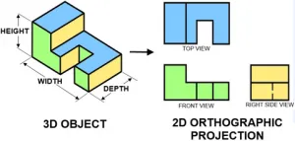
Orthographic Projection
Orthographic projection is a way of representing a three-dimensional object in two dimensions.

Slide 4
SIDE VIEW
FRONT VIEW
TOP VIEW

Slide 5
FRONT VIEW
SIDE VIEW
FRONT VIEW
SIDE VIEW
TOP VIEW
45
degree
TOP VIEW

Slide 6
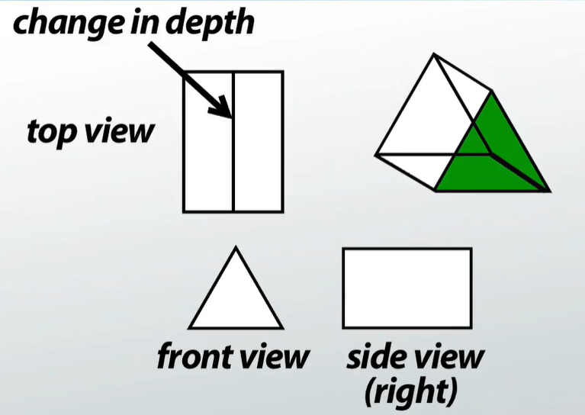

Slide 7
VIEWS OF ORTHOGRAPHIC PROJECTION:
There are three main views of Orthographic projection such as:
Front view
Top view
Side view
FRONT VIEW:
These views are prepared by placing the object in front, and in this view, the height and length of the object are shown.
TOP VIEW:
By looking at the object from the upper side, this view is prepared, and in this view length and breadth of an object is shown.
SIDE VIEW:
By looking at the object from the left side or right side, this view is prepared, and in this view breadth and height of an object is shown.

Slide 8
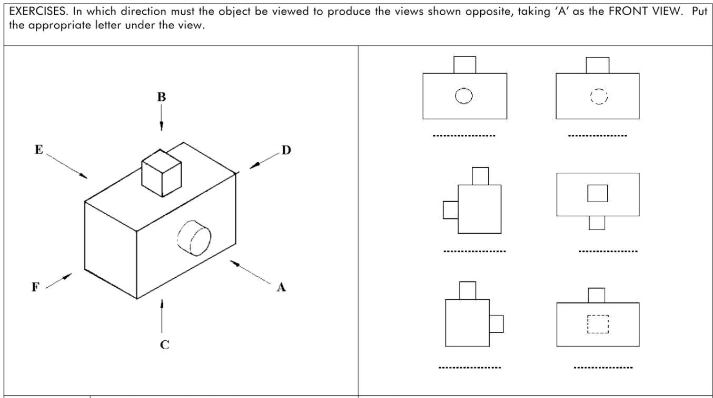






Slide 9
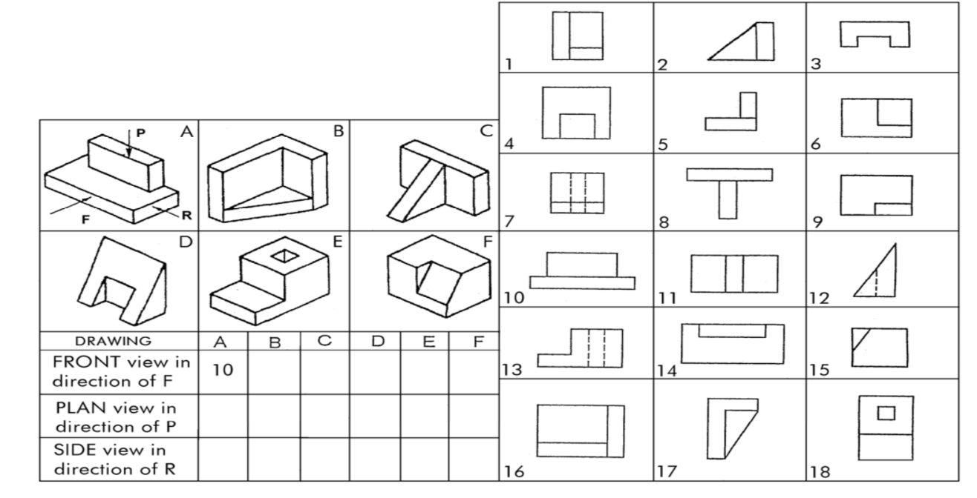

Slide 10
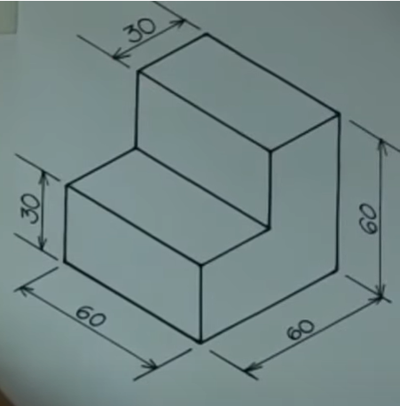
FRONT VIEW
SIDE VIEW
60
30
60
30
60
Determine the bounding box of the object
45
degree
TV
SV
FV
TOP VIEW

